Slide 1
Chapter FIVE
Link Layer and Physical Layer

Slide 2
Data Link Layer

Slide 3
Data Link Layer
The data link layer is responsible for moving frames from one hop (node) to the next.
The Data Link layer is responsible for communications between end-device network interface cards.
It allows upper layer protocols to access the physical layer media and encapsulates Layer 3 packets (IPv4 and IPv6) into Layer 2 Frames.
The data link layer receives the packets from network layer and creates FRAMES , add physical address to these frames & pass them to physical layer
It also performs error detection and rejects corrupted frames.

Slide 4
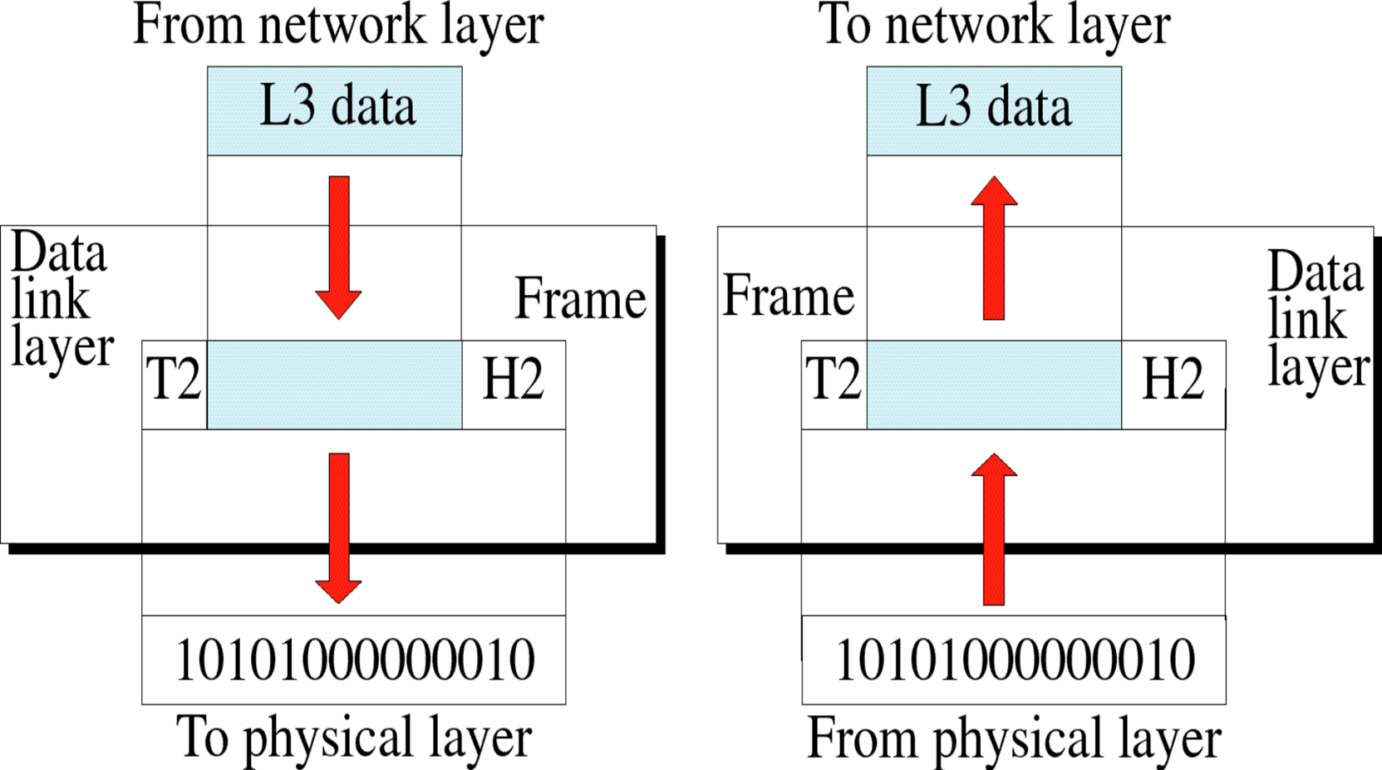
Cont..

Slide 5
Link layer services
Framing : data link layer adds header and trailer to the data received from network layer and turns it into frames. (Frame contains all the addressing information necessary to travel from Source to Destination).
Flow Control: data link layer prevents the fast sender from drowning the slow receiver.
Error Control: It provides the mechanism of error control in which it detects & retransmits damaged or lost frames.
Access Control: When single communication Channel is shared by multiple devices, MAC layer of data link layer provides help to determine which device has control over the channel.

Slide 6
Framing
Data is encapsulated by the data link layer with a header and a trailer to form a frame.
A data link frame has three parts:
Header
Data
Trailer
The fields of the header and trailer vary according to data link layer protocol.
The amount of control information carried with in the frame varies according to access control information and logical topology.

Slide 7
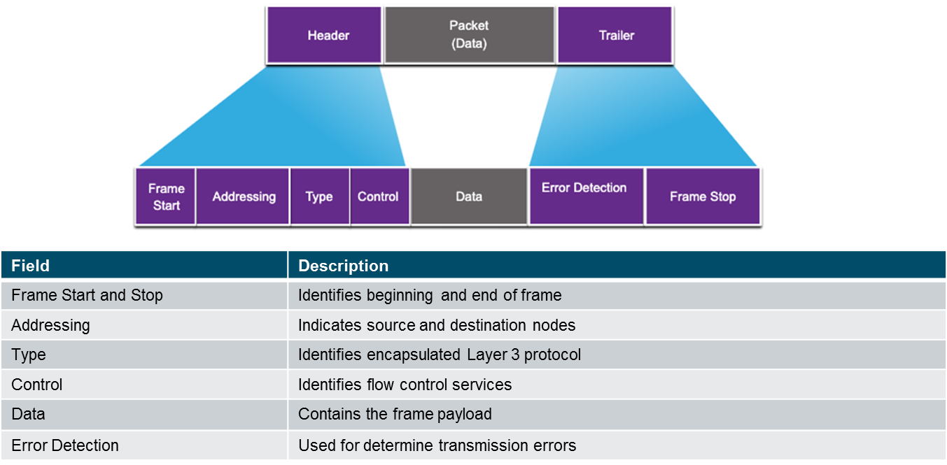

Slide 8
Data Link Sub Layers
The Data Link Layer consists of two sublayers. Logical Link Control (LLC) and Media Access Control (MAC).
The LLC sublayer communicates between the networking software at the upper layers and the device hardware at the lower layers.
Places information in the frame to identify which network layer protocol is used for the frame.
The MAC sublayer is responsible for data encapsulation and media access control.
Responsible for data encapsulation and media access control, and provides data link layer addressing.

Slide 9
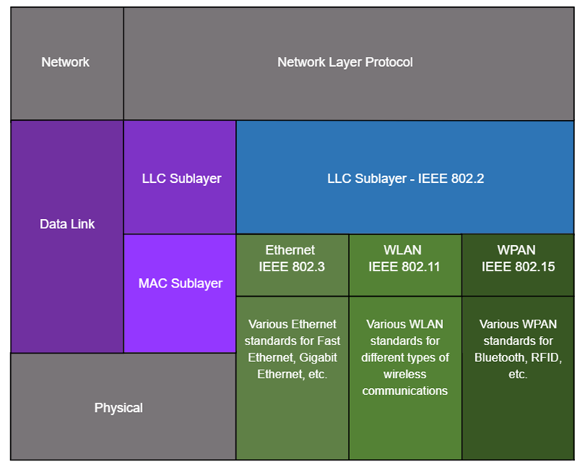

Slide 10
Multiple Access Protocols
These protocols allow a number of nodes or users to access a shared network channel.
Multiple Access Protocols required to decrease collision.
Eg. All nodes operating in half-duplex, competing for use of the medium.
Multiple Access Protocols
Carrier sense multiple access with collision detection (CSMA/CD) as used on legacy bus-topology Ethernet.
Carrier sense multiple access with collision avoidance (CSMA/CA) as used on Wireless LANs.

Slide 11
CSMA/CD and CSMA/CA
CSMA/CD
Used by Ethernet LANs.
Operates in half-duplex mode where only one device sends or receives at a time.
Uses a collision detection process to govern when a device can send and what happens if multiple devices send at the same time.
CSMA/CD collision detection process:
Devices transmitting simultaneously will result in a signal collision on the shared media.
Devices detect the collision.
Devices wait a random period of time and retransmit data.

Slide 12
Cont..
CSMA/CA
Used by IEEE 802.11 WLANs.
Operates in half-duplex mode where only one device sends or receives at a time.
Uses a collision avoidance process to govern when a device can send and what happens if multiple devices send at the same time.
CSMA/CA collision avoidance process:
When transmitting, devices also include the time duration needed for the transmission.
Other devices on the shared medium receive the time duration information and know how long the medium will be unavailable.

Slide 13
Data Link and its responsibilities
Data Link Control
When a data frame (Layer-2 data) is sent from one host to another over a single medium, it is required that the sender and receiver should work at the same speed.
That is, sender sends at a speed on which the receiver can process and accept the data.
What if the speed (hardware/software) of the sender or receiver differs?
If sender is sending too fast the receiver may be overloaded, (swamped) and data may be lost.

Slide 14
Cont..
Error detection and correction
Error control is both error detection and error correction.
It allows the receiver to inform the sender of any frames lost or damaged in transmission and coordinates the retransmission of those frames by the sender.
In the data link layer, the term error control refers primarily to methods of error detection and retransmission.
Error control in the data link layer is often implemented simply: Any time an error is detected in an exchange, specified frames are retransmitted.
This process is called automatic repeat request (ARQ).
Error control in the data link layer is based on automatic repeat request, which is the retransmission of data.

Slide 15
Data Link Layer Protocols
Synchronous Data Link Protocol (SDLC) − SDLC was developed by IBM in the 1970s as part of Systems Network Architecture. It was used to connect remote devices to mainframe computers. It ascertained that data units arrive correctly and with right flow from one network point to the next.
High Level Data Link Protocol (HDLC) − HDLC is based upon SDLC and provides both unreliable service and reliable service.
Serial Line Interface Protocol (SLIP) − This is a simple protocol for transmitting data units between an Internet service provider (ISP) and home user over a dial-up link. It does not provide error detection / correction facilities.

Slide 16
Physical Layer

Slide 17
Physical Layer
It is responsible for the actual physical connection between the devices. Such physical connection may be made by using twisted pair cable.
It is concerned with transmitting bits over a communication channel.
the Physical layer is responsible for ultimate transmission of digital data bits from the Physical layer of the sending (source) device over network communications media to the Physical layer of the receiving (destination) device.
The Physical layer has two responsibilities: it sends bits and receives bits.
The Physical layer communicates directly with the various types of actual communication media.
Different kinds of media represent these bit values in different ways.

Slide 18
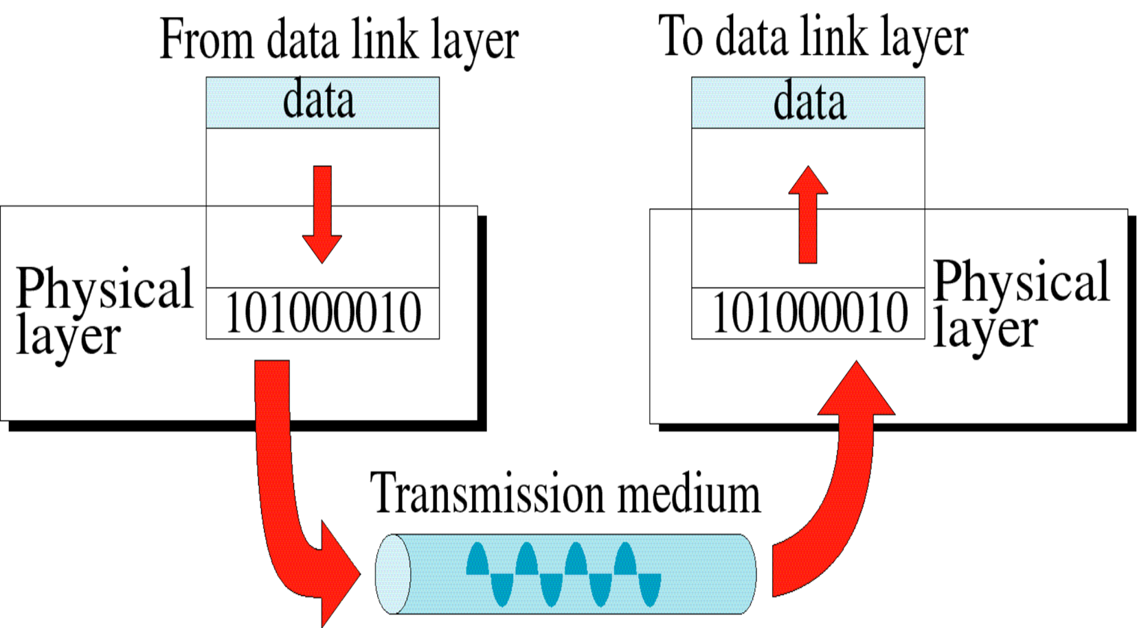

Slide 19
Cont..
The physical layer is concerned with :
Physical characteristics of interfaces and medium:-.
Representation of bits into signals
Data rate
The Line configuration:-
Physical topology
Transmission mode

Slide 20
Signaling and encoding
Encoding converts the stream of bits into a format recognizable by the next device in the network path.
This ‘coding’ provides predictable patterns that can be recognized by the next device.
The signaling method is how the bit values, “1” and “0” are represented on the physical medium.
The method of signaling will vary based on the type of medium being used.

Slide 21
Bits
Physical layer transports bits across the network media
Accepts a complete frame from the Data Link Layer and encodes it as a series of signals that are transmitted to the local media
This is the last step in the encapsulation process.
The next device in the path to the destination receives the bits and re-encapsulates the frame, then decides what to do with it.

Slide 22
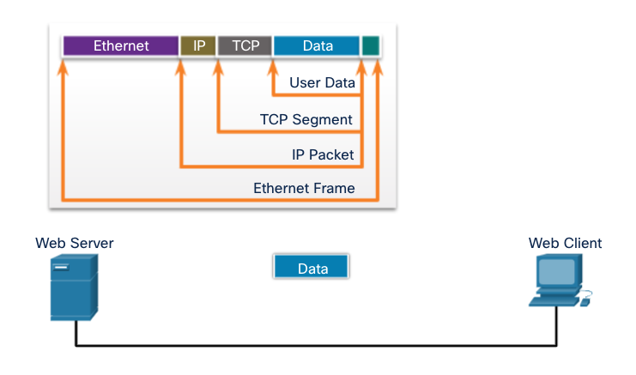
Ethernet
Ethernet is the traditional technology for connecting devices in a wired local area network (LAN) or wide area network (WAN).
It enables devices to communicate with each other via a protocol, which is a set of rules or common network language.

Slide 23
Point-to-Point Protocol
It is a communication protocol of the data link layer that is used to transmit multiprotocol data between two directly connected (point-to-point) computers.
one of the most common protocols for point-to-point access is the Point-to-Point Protocol (PPP).
Today, millions of Internet users who need to connect their home computers to the server of an Internet service provider use PPP.
The majority of these users have a traditional modem; they are connected to the Internet through a telephone line, which provides the services of the physical layer.
But to control and manage the transfer of data, there is a need for a point-to-point protocol at the data link
layer.
PPP is by far the most common.

Slide 24
Cont..
PPP provides several services:
1. PPP defines the format of the frame to be exchanged between devices.
2. PPP defines how two devices can negotiate the establishment of the link and the exchange of data.
3. PPP defines how network layer data are encapsulated in the data link frame.
4. PPP defines how two devices can authenticate each other.
5. PPP provides multiple network layer services supporting a variety of network layer protocols.
6. PPP provides connections over multiple links.
7. PPP provides network address configuration. This is particularly useful when a home user needs a temporary network address to connect to the Internet.

Slide 25
Cont..
On the other hand, to keep PPP simple, several services are missing:
1. PPP does not provide flow control. A sender can send several frames one after another with no concern about overwhelming the receiver.
2. PPP has a very simple mechanism for error control. A CRC field is used to detect errors.
If the frame is corrupted, it is silently discarded; the upper-layer protocol needs to take care of the problem.
Lack of error control and sequence numbering may cause a packet to be received out of order.
3. PPP does not provide a sophisticated addressing mechanism to handle frames in a multipoint configuration.

Slide 26
LAN Devices:
Repeaters, Hubs, Bridges and switches

Slide 27
WAN Devices
Routers, Layer 3 Switches and Gateways

Slide 28
Physical Layer and its responsibilities
Modulates the process of converting a signal from one form to another so that it can be physically transmitted over a communication channel
Bit-by-bit delivery
Line coding, which allows data to be sent by hardware devices that are optimized for digital communications that may have discreet timing on the transmission link
Forward error correction/channel coding such as error correction code

Slide 29
End of chapter 5

